Slide 1
Exactrix Producer Meeting
December 7,2016
Ben McClure
Kramer Seed Farms
Hugoton, KS

Slide 2
Kramer Seed Farms
Multi-generational family farm
2 brothers, 2 sons, and a guy named Ben
Managing Partner on site in Hugoton, KS
Mostly absentee owners or little involvement other than wanting a ROI
  (return on investment)
100% Cash rent
About 3,500 acres
About 95% center pivot irrigation
10 - 1200 to 1800 gpm wells pumping from around 220’
Usually about 2/3 corn with some cotton, grain sorghum, or sunflowers thrown in
Usually about 1/3 wheat planted behind corn
  Certified seed wheat business adds value to the wheat crop
Started with Exactrix in 2010 (I think)

Slide 3
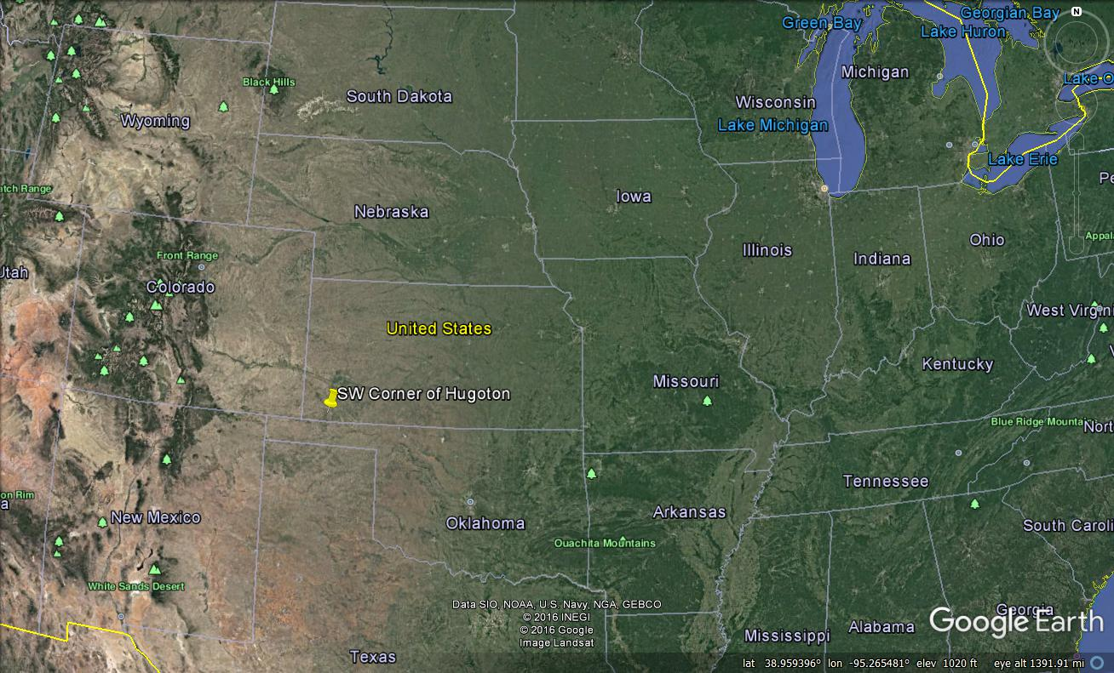

Slide 4
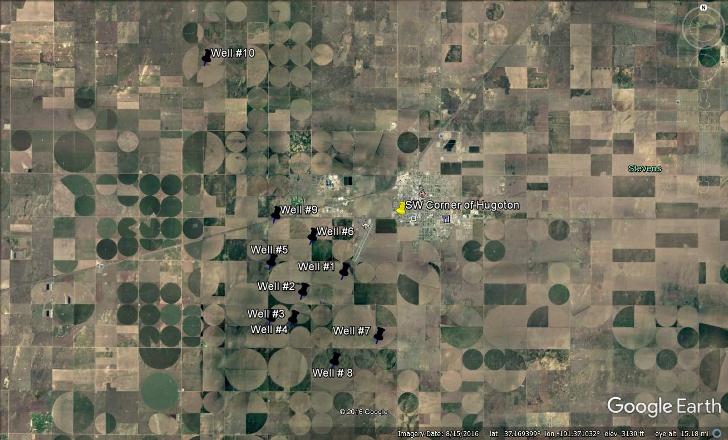

Slide 5
B.E. (Before Exactrix)
Strip-till
100% Liquid Fertilizer
Had done VR fertilizer
Extensive grid sampling
Started on VR Seeding

Slide 6
A.E. (After Exactrix)
Converted a 2510 DMI 30 foot /30” strip-till bar
Added a 30 foot 15” coulter bar
  Added mostly to sidedress wheat in January when snow is hopefully on the ground
  Allows sidedress double crop sunflowers
Move Exactrix engines from bar to bar
Variable rate fertilizer with two products
  Third is in the future
VR seeding
Major plots repeated three years in same locations proved the economics
No drop in yields
Saved $$$,$$$’s over a few years
Quick Return of Investment

Slide 7
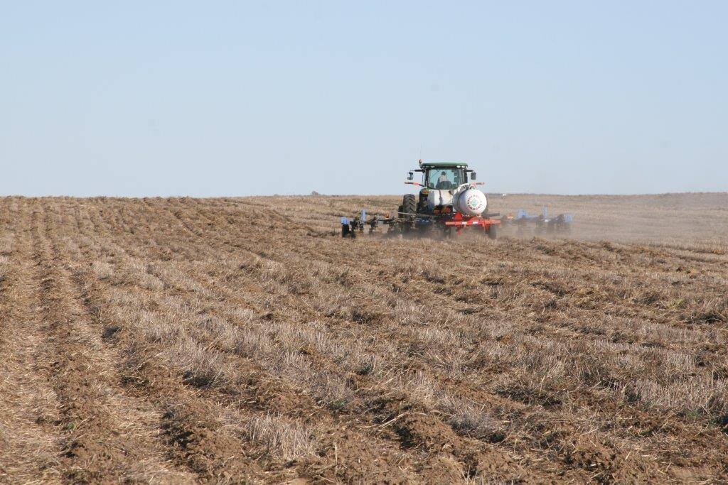
Strip-tilling into wheat stubble

Slide 8
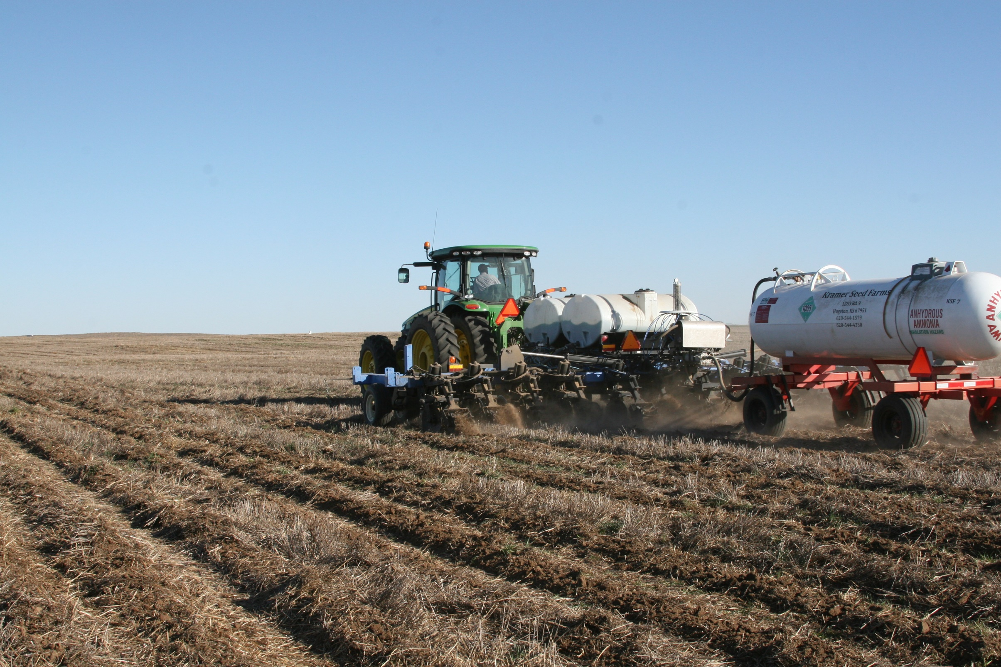
Top outlet tanks are working, but with higher app rates bottom outlet tanks would be needed!

Slide 9
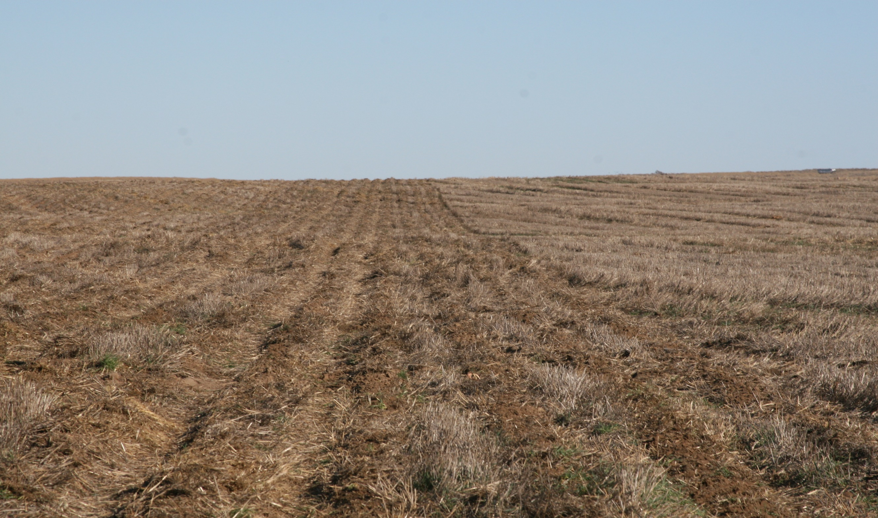
Top outlet tanks are working, but with higher app rates we would need to go to bottom outlets

Slide 10
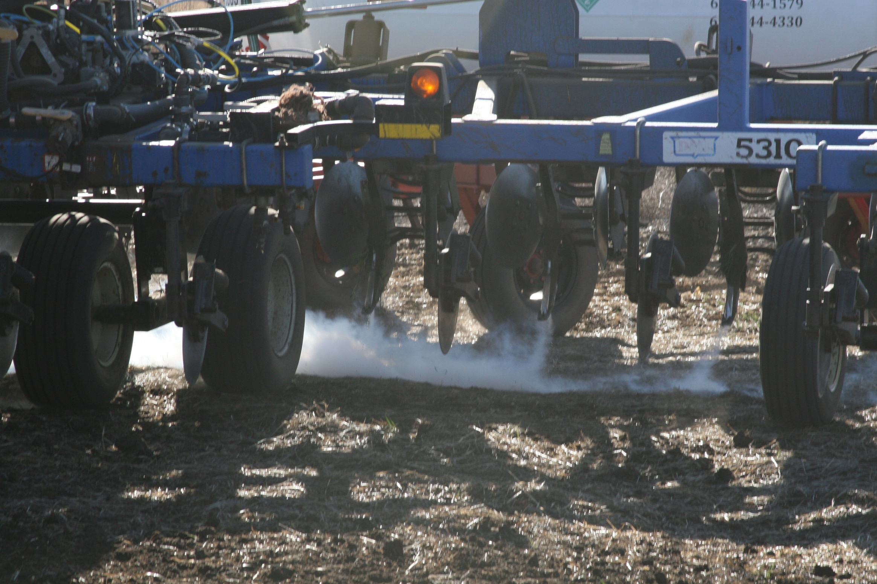

Slide 11
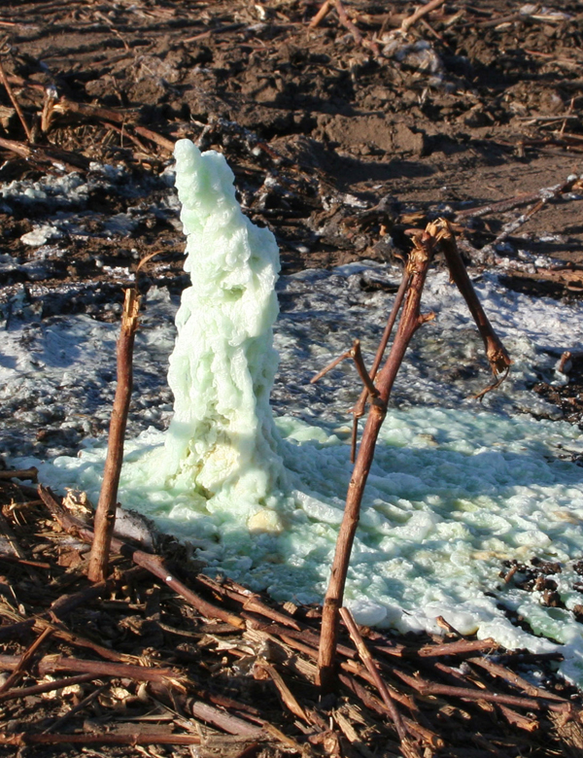
Juan the stripper!
TAPPS!

Slide 12
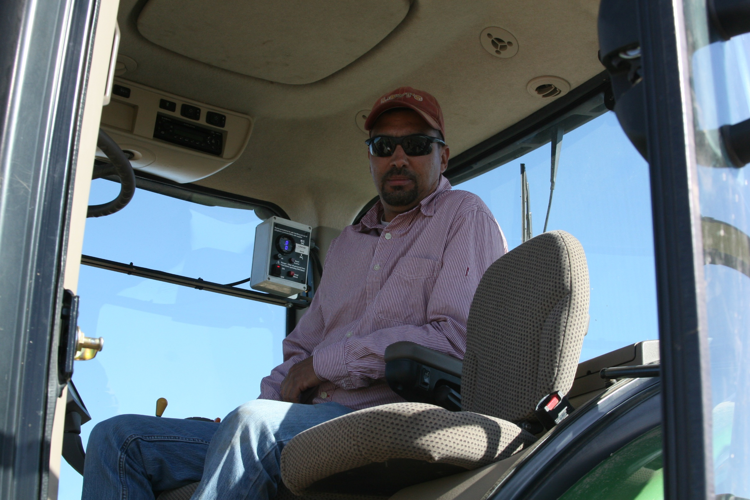
Juan the stripper!

Slide 13
2016 Year in Review
Yield Goal – 220 bushels per acre
141.84 average #N applied

Slide 14
Seeding Rate

Slide 15
Late May – 8” of rain in two weeks!
What did the soil tests show?
144# N in top 2’
Only applied 141 on average!
Keep in mind single digit carryover to start the year!
Scout had recommended applying additional 50# through the pivot. Still thought it would be a good idea
Final yield – 264 bushels per acre!

Slide 16
Economics
Scenario 1 – Strip-till - all dry
  Urea and 11-52-0
  All fertilizer placed with strip-till
Scenario 2 – Strip-till – dual placement
  Nh3 and 10-34-0
  2/3 placed with strip-till
  1/3 placed with sidedress
  No N-Serve or nitrogen stabilizer
Scenario 3 – Strip-till – Exactrix
  Nh3, 10-34-0, 12-0-0-26S
  All placed at strip-till
Scenario 4 – Strip-till – All liquid
  2/3 N placed with strip-till
  1/3 N fertigated

Slide 17
Economics
Urea - $315/ton
11-52-0 - $445/ton
Nh3 - $395/ton
10-34-0 - $365/ton
*12-0-0-26S - $355/ton
32% - $219/ton
*Have used KTS (0-0-25-17S) when potassium was needed - $670/ton

Slide 18
Economics
 |  |  |  |  | Scenario 1 | Scenario 2 | Scenario 3 | Scenario 4
INCOME
 |  |  | Average Yield | 220
 |  |  | $ / Bushel | $ 3.50
 | Gross Income |  |  |  | $ 770.00 | $ 770.00 | $ 770.00 | $ 770.00

Slide 19
Economics
EXPENSES |  |  |  |  |  |  |  | Scenario 1 | Scenario 2 | Scenario 3 | Scenario 4
 | Fertilizer |  |  | lbs. | $/lb | Total$
 |  | Scenario 1 - Striptill - ALL DRY
 |  |  | Pre-Plant - Urea | 600 | $ 0.1575 | $ 94.50
 |  |  | Pre - Plant - 11-52-0 | 115 | $ 0.2225 | $ 25.59 |  | $ 120.09
 |  |  | NPKS | N | P | K | S
 |  |  |  | 288.7 | 59.8 | 0 | 0
 |  | Scenario 2 - Striptill - Dual Placement
 |  |  | Pre-Plant NH3 | 225 | $ 0.1975 | $ 44.44
 |  |  | Pre-Plant 10-34-0 | 175 | $ 0.1825 | $ 31.94
 |  |  | Side Dress NH3 | 105 | $ 0.1975 | $ 20.74 |  |  | $ 97.11
 |  |  | NPKS | N | P | K | S
 |  |  |  | 288.1 | 59.5 | 0 | 0
 |  | Scenario 3 - Striptill - EXACTRIX TAPPS
 |  |  | Pre-Plant NH3 | 160 | $ 0.1975 | $ 31.60
 |  |  | Pre-Plant 10-34-0 | 105 | $ 0.1825 | $ 19.16
 |  |  | Pre-Plant 12-0-0-26S | 65 | $ 0.1775 | $ 11.54 |  |  |  | $ 62.30
 |  |  | NPKS | N | P | K | S
 |  |  |  | 149.5 | 35.7 | 0 | 16.9
 |  | Scenario 4 - Striptill - ALL LIQUID
 |  |  | Pre-Plant 32% | 700 | $ 0.1095 | $ 76.65
 |  |  | Pre-Plant 10-34-0 | 175 | $ 0.1825 | $ 31.94
 |  |  | Fertigate 32% | 150 | $ 0.1095 | $ 16.43 |  |  |  |  | $ 125.01
 |  |  | NPKS | N | P | K | S
 |  |  |  | 289.5 | 59.5 | 0 | 0

Slide 20
Economics
EXPENSES |  |  |  | Scenario 1 | Scenario 2 | Scenario 3 | Scenario 4
 | Fertilizer |  |  | $ 120.09 | $ 97.11 | $ 62.30 | $ 125.01
 | Seed |  |  | $ 105.19 | $ 105.19 | $ 105.19 | $ 105.19
 | Herbicides |  |  | $ 51.93 | $ 51.93 | $ 51.93 | $ 51.93
 | Insectides |  |  | $ 15.67 | $ 15.67 | $ 15.67 | $ 15.67
 | Fungicides |  |  | $ 13.93 | $ 13.93 | $ 13.93 | $ 13.93
 | Crop Insurance |  |  | $ 21.38 | $ 21.38 | $ 21.38 | $ 21.38
 | Crop Consulting |  |  | $ 7.50 | $ 7.50 | $ 7.50 | $ 7.50
 | Repairs |  |  | $ 12.00 | $ 12.00 | $ 12.00 | $ 12.00
 | Labor |  |  | $ 28.00 | $ 28.00 | $ 28.00 | $ 28.00
 | Custom Field Operations |  |  | $ 124.09 | $ 126.55 | $ 124.09 | $ 124.09
 | Pumping Costs |  |  | $ 63.00 | $ 63.00 | $ 63.00 | $ 63.00
 | Miscellaneous |  |  | $ 10.00 | $ 10.00 | $ 10.00 | $ 10.00
 | Land Rent - Cash Rent |  |  | $ 100.00 | $ 100.00 | $ 100.00 | $ 100.00
 | Interest on Opearting Expenses - 7% |  |  | $ 23.90 | $ 22.38 | $ 19.86 | $ 24.24
 | Total Operating Expenses |  |  | $ 696.67 | $ 674.64 | $ 634.84 | $ 701.94

Slide 21
Summary
 |  |  | Scenario 1 | Scenario 2 | Scenario 3 | Scenario 4
 |  |  | Dry | Dual | Exactrix | Liquid
Gross Income |  |  | $ 770.00 | $ 770.00 | $ 770.00 | $ 770.00
Total Operating Expenses |  |  | $ 696.67 | $ 674.64 | $ 634.84 | $ 701.94
EBID (Earnings Before Interest & Depreciation) |  |  | $ 73.33 | $ 95.36 | $ 135.16 | $ 68.06
 |  | Exactrix Advantage | $ 61.83 | $ 39.79 | - | $ 67.10
 |  | Fertilizer Expense as % of Gross Income | 15.60% | 12.61% | 8.09% | 16.24%

Slide 22
Conclusion
$30-$70 more per acre to cover depreciation, interest on fixed costs, profits
$30 x 2,500 acres = $75,000 a year
$70 x 2,500 acres = $175,000 a year
One year payback on equipment investment is real easy!
The next year it’s yours to keep!

Slide 23
NH3 Storage
Transport loads of NH3 are $60/ton less than buying by the trailer
Dealers get more aggressive with pricing if they know you can shop around.
  2,500 acres
  Average app – 160# NH3
  200 tons
  $12,000 a year in savings on corn ground alone
  Invested about $65,000
    2 – 18,000 gallon storage tanks
    4 fill stations
    7 – 1,000 gallon nurse tanks
  Not beholden to one fertilizer dealer
  Fill out of season (may be worth $100’s/ton when prices go up, but can get caught on the wrong side as well!)
  Best buy – had room for a load when local dealer over ordered. Got a rain, no field work for several days, had two loads he could not divert to their other locations, got 40 tons at cost!

